Slide 1
Spark Streaming Application
Pravin Y Pawar

Slide 2
Introducing Spark Streaming
First stream processing framework built on top of Spark’s distributed processing capabilities
Widely adapted in the industry for large scale data streams
Spark RDD abstraction
Permits creation of programs that treat distributed data as a collection
Allows applying data processing logic in form of transformation of distributed dataset
Spark Streaming created upon simple yet powerful premise
apply Spark’s distributed computing capabilities to stream processing by transforming a continuous stream of data into discrete data collection on which Spark could operate
Main task is to take data from stream, package it down into small batches and provide them to Spark for further processing

Slide 3
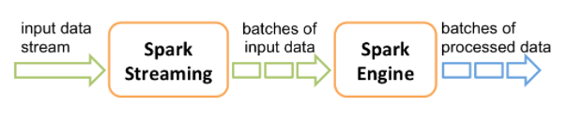
The DStream Abstraction
Spark streaming relies on the much more fundamental Spark abstraction of RDD
Introduces a new concept : The Discretized Stream or DStream
DStream represents a stream in terms of discrete block of data that in turn are represented as RDDs over time
Primarily an execution model that when combined with functional programming model, provides a complete framework to develop and execute streaming applications

Slide 4
DStreams as a Programming model
Code representation
Provides functional programming APIs consistent with RDD APIs and augmented with stream specific functions to deal with
Aggregations
Time based operations
Stateful computations
In Spark Streaming, we
Consume a stream by creating Dstream form one of the native implementations or the connectors available
From SocketInputStream or Kafka / Twitter / Kinesis connector
Implement application logic using functions provided by Dstream API
Such as counting the elements or grouping the elements
Uses transformations – no execution happens unless output operation is not called
Execute output operations to yield out the results
DStream programming model consists of functional composition of transformations over the stream payload, materialized by one or more output operations and recurrently executed by Spark engine

Slide 5
DStreams as an Execution model
Batch interval
In programming model, its descried how data is transformed from original form to intended result as a series of lazy evaluations
Spark streaming engine is responsible for taking that chain of transformations and turning it into an actual execution plan
Happens by receiving data from input stream(s), collecting that into batches and feeding to spark in timely manner
The measure of time to wait for data in batch interval
Central unit of time
Short amount of time, ranging from 200ms to 1 min, depending app’s latency requirement
At each batch interval, the data corresponding to the previous interval is sent to Spark for processing while new data is received
Process is repeated as long as Streaming job is active and healthy
DStream model dictates that a continuous stream of data is discretized into micro batches using a regular time interval

Slide 6
The structure of Spark Streaming Application
Any Spark streaming application needs to do following four things:
Create a Spark Streaming Context
Define one or more DStreams from data sources or other Dstreams
Define one or more output operations to materialize the results of these DStream operations
Start the Spark Streaming Context to get the Stream Processing going on
Points to note
Behaviour of job is defined in the operations between the moment that the instance of Streaming context is defined and the moment it is started
Manipulation of the context defines the scaffolding for the streaming application – behaviour and execution for the duration of application
During the definition phase, all the Dstreams and transformations will be defined and behaviour of Spark streaming application will be wired
Once the Spark Streaming context is started, no new Dstreams can be added or it nor can any existing DStream can be structurally modified

Slide 7
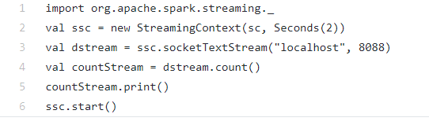
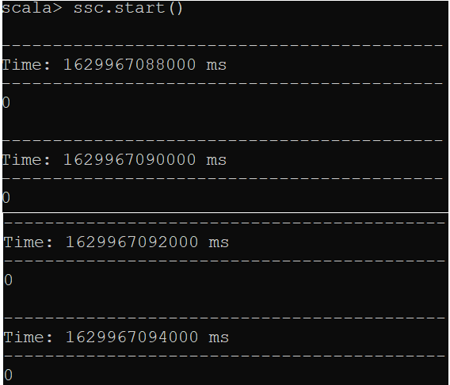
Example

Slide 8
Thank You!
Reference
Stream Processing with Apache Spark
Mastering Structured Streaming and Spark Streaming
By Gerard Maas and Francois Garillot
In our next session:

